Slide 1
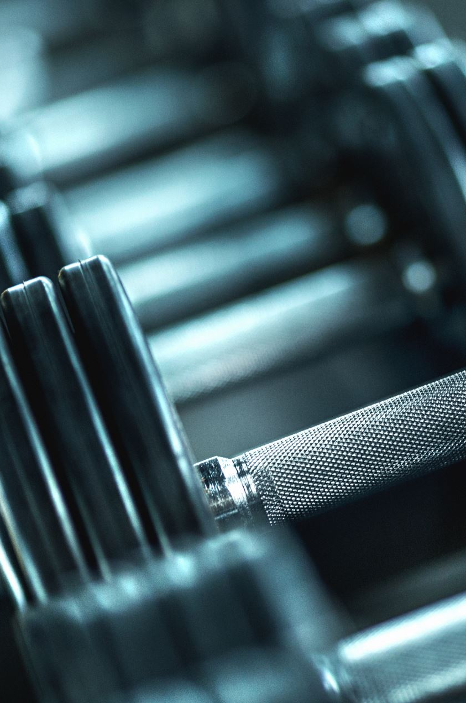
Correctness of Fitness Movements using Machine Learning
Jeler Andrei-Iulian
Supervisor: Dr. BORZA Diana-Laura

Slide 2
Motivation
The number of injuries resulted from fitness activities (around 7.2 million of British people during the first 4 months of the pandemic [1])
Bad execution of the exercises that can result in a lower effectiveness of the activity
Notes:
Firstly, I would like to present the motivation behind this thesis

Slide 3
Main Objective
Create an application that can detect how well an exercise is executed and give some form of feedback to the user
The application can be used to help the user reduce the number of small injuries during fitness activities and make the effectiveness greater on the desired body part

Slide 4
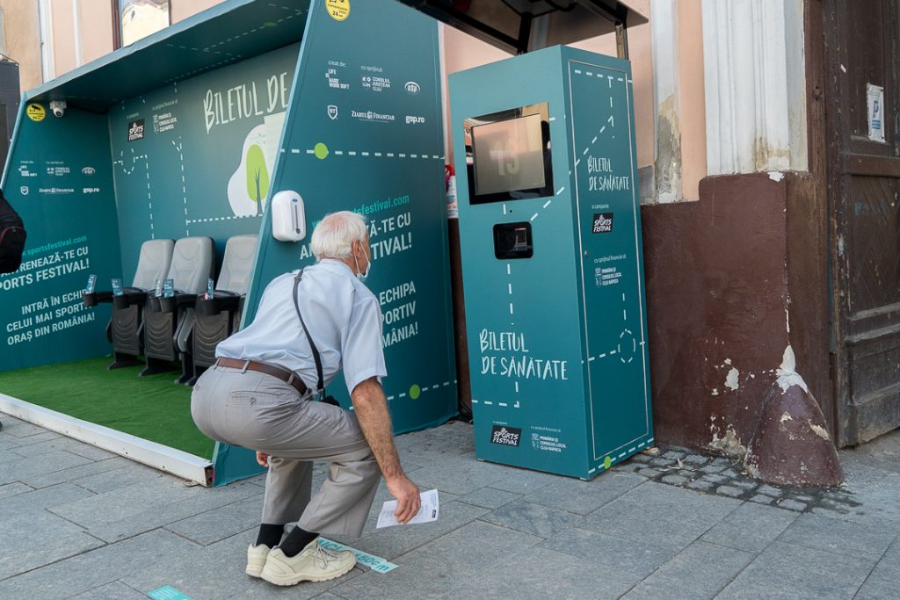
Biletul de Sanatate^{[2]}
It was an initiative of Sports Festival that happened during an extended period of time
The device counted the number of repetitions made (up to 20)

Slide 5
Related Works
Levan Sanadiradze presents in [3] a solution for counting squats by using a CNN trained directly with images of himself for the different stages of performing the exercise
The solution proposed in [4] is creating, for each frame, a temporal distance matrix (matrix that contains all the available distances between a pair of joints) that is passed into a 1D convolution to find possible mistakes in squats executions

Slide 6
Proposed Solution
A system that can take the feed of a webcam, Kinect, or even a video recorded before and analyze the execution
Three exercises were implemented: Squats, Bicep curls and Shoulder presses
Two approaches were done

Slide 7
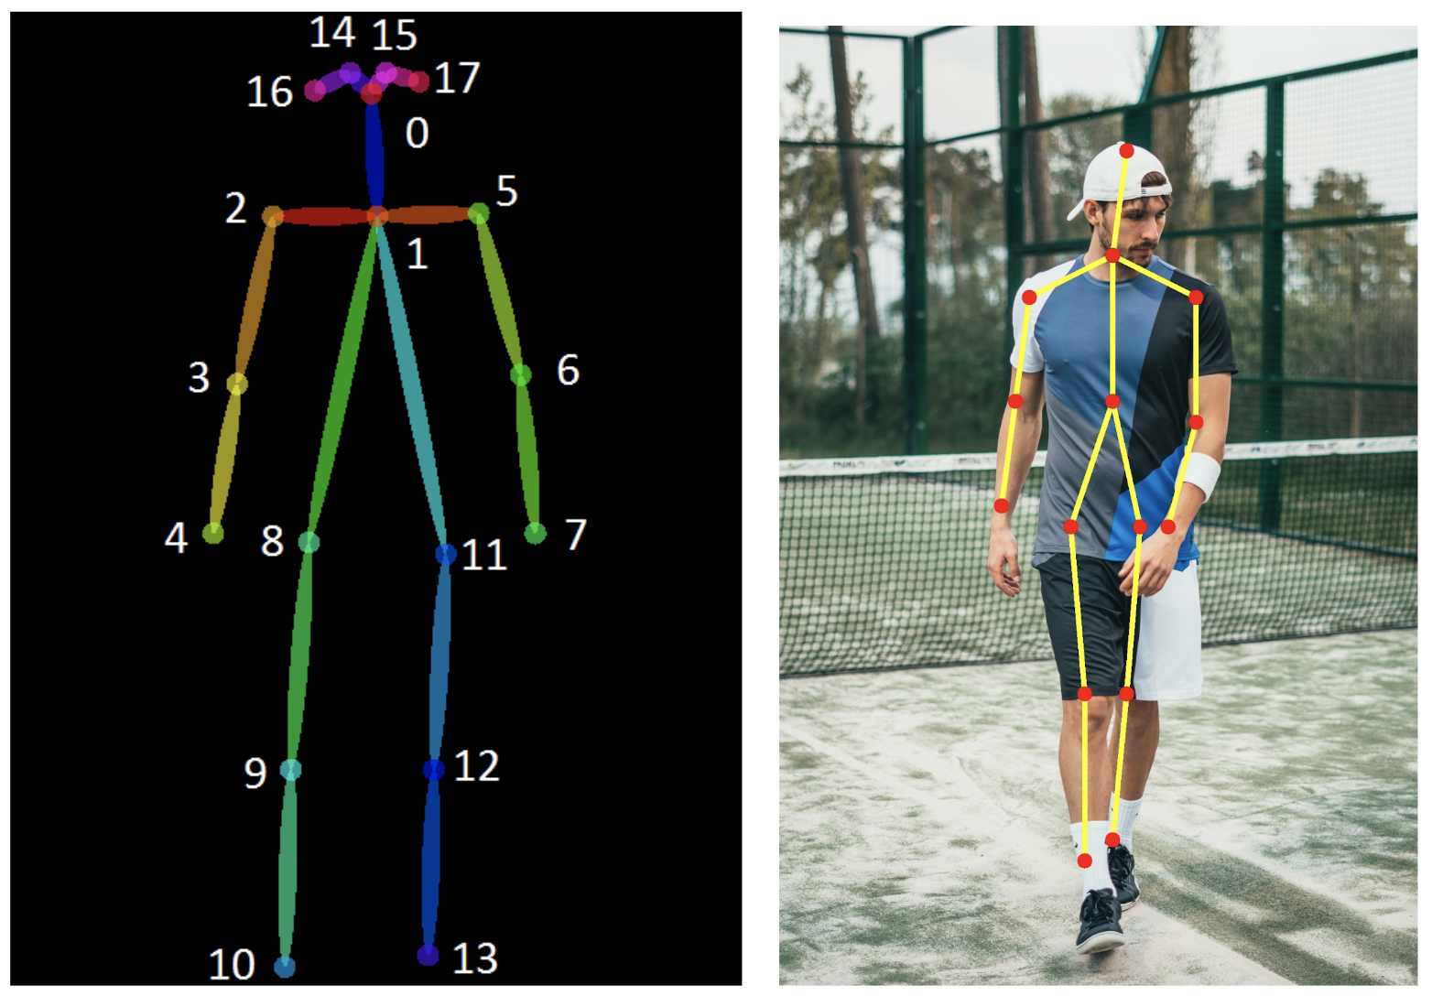
Human Pose Estimation^{[6]}
It is a Computer Vision problem which is a crucial step in understanding people in images and videos
It is defined as being the problem of localization of human joints (known as keypoints, such as elbow, wrist, etc) in images or videos

Slide 8
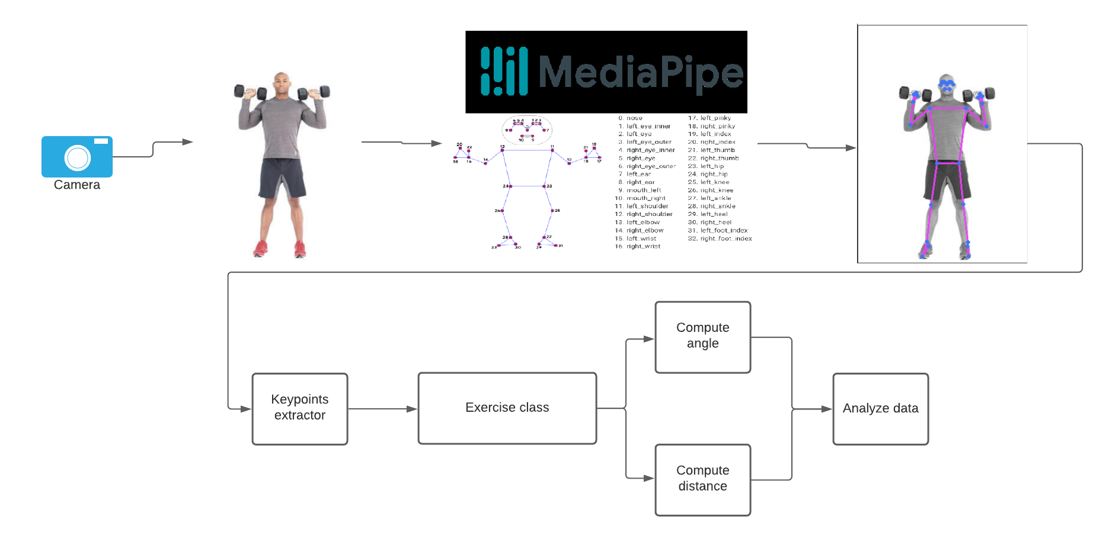
Approach 1: Rule Based
The computations are made by hand in code, checking each frame if a given condition is met

Slide 9
Approach 2: Machine learning Based
For this approach the process is divided in 2 subtasks: one that is responsible for checking the current state of the repetition (is at start or end) and one that is checking multiple consecutive frames looking for possible mistakes
Multiple neural network configurations were made and tested

Slide 10
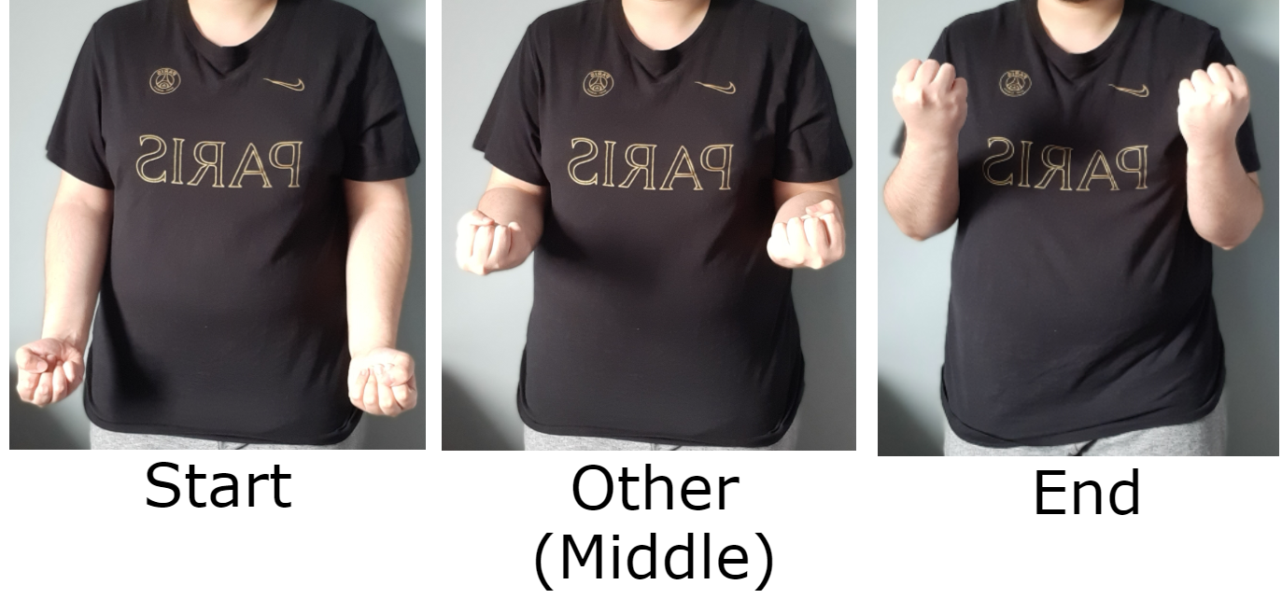
Repetition State(Stage)
Determine the state in which the repetition is for the current frame
In order for the repetition to be counted, a full cycle from start to end must be done
Simple Neural Network was used, consisting of dense layers

Slide 11
LSTM – Recurrent Neural Network
RNN’s are a type of artificial neural network designed to recognize patterns in sequences of data, such as numerical times series, videos, etc [7]
LSTM’s are a solution for short-term memory of RNN’s [8]

Slide 12
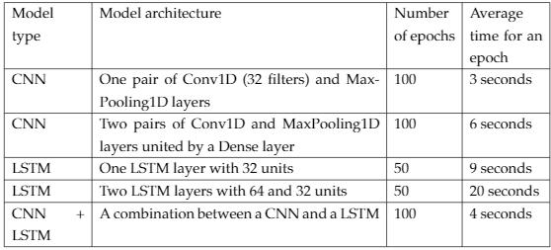
Correctness Checker
This task needs to check multiple consecutive frames and predict if a mistake was made
In this case a temporal dimension appears, so a RNN can be used, more precisely LSTM
For creating this checker, multiple configurations were made: CNN, LSTM and CNN+LSTM

Slide 13
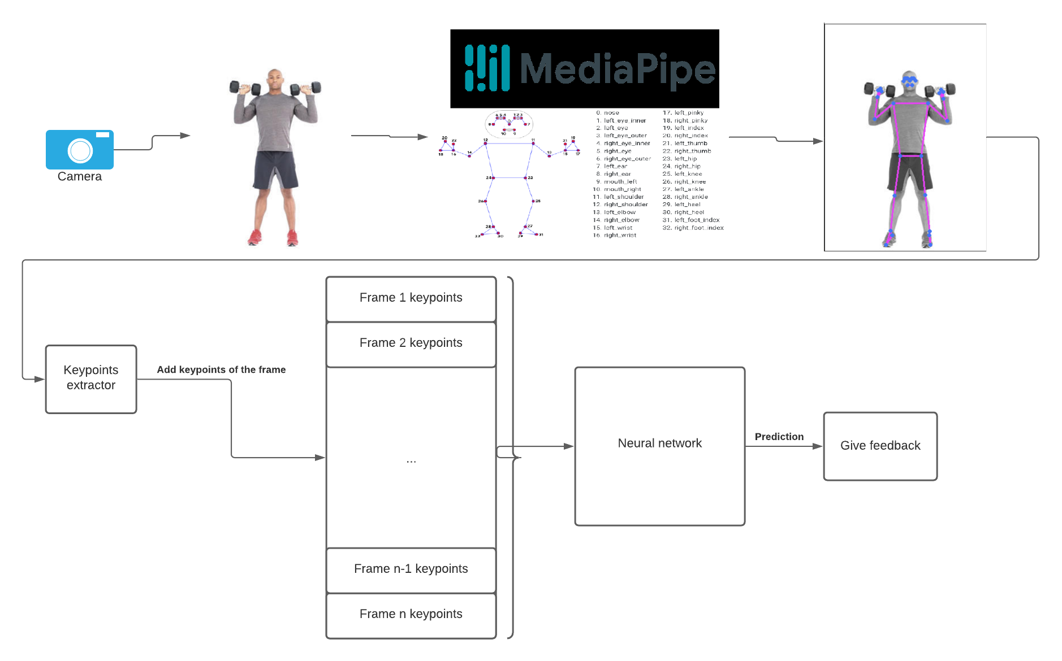

Slide 14
Labels
For the repetition status checker: Start, End and Others
For each exercise, different labels for mistakes:
Squat: Good, Back (arched back), Legs (knees carving in)
Shoulder press: Good, Bad (the arms are not straight)
Biceps curls: Good, Fast, Others (unnecessary body movements)

Slide 15
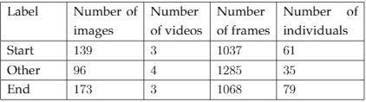
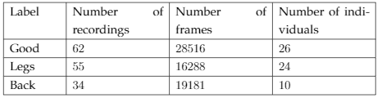
Datasets
Images and videos of executions of these exercises were captured and preprocessed in csv files using a Human Pose Estimator pipeline (Mediapipe)
The coordinates of the keypoints are stored in the csv files, together with the visibility percentage of each one
Actors: myself, my brother and other individuals from the internet
Statistics for the squats datasets
Repetition status
Correctness check

Slide 16
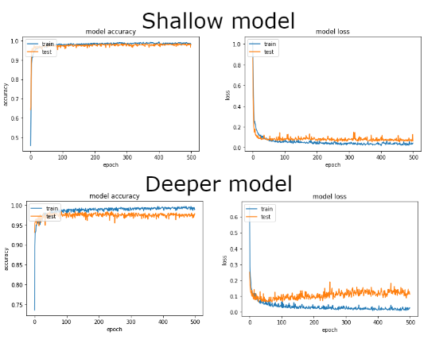
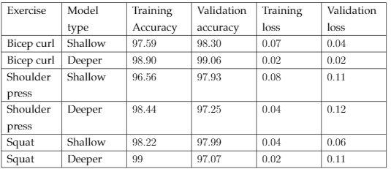
Results
Model loss and accuracy are used for comparison
The solution presented in [3] has a final validation loss of 0.4305 and a validation accuracy of 79.98%

Slide 17
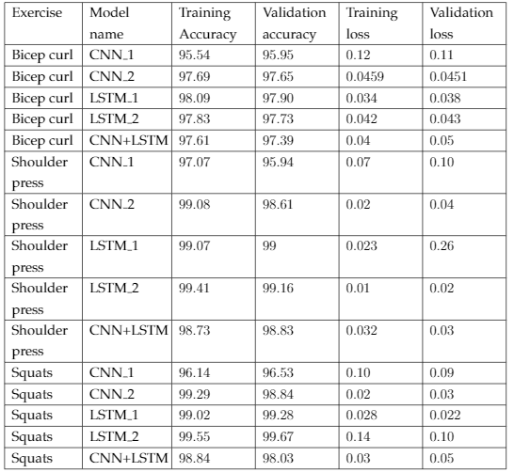
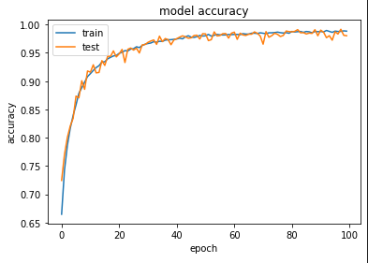
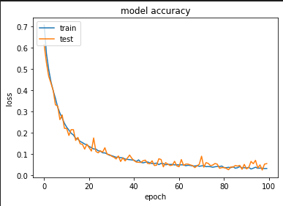
model loss
The solution presented in [4] has a final accuracy of 75%, using 128 frames for predicting
Another similar solution uses inertial sensors placed on the body, the data stream being sent to a Random forest or CNN+LSTM combo neural network, obtaining an accuracy of 75.4% for the Random Forest and 91.7% for the CNN+LSTM combo [5]

Slide 18
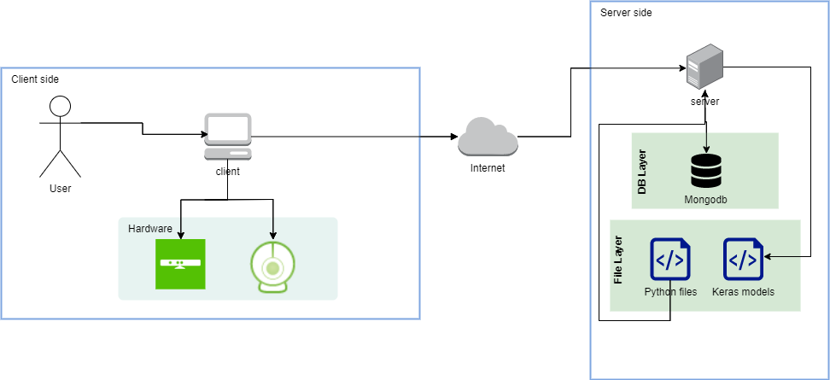
Application
Client-Server application in which the server sends the NN models to the client and stores the history of activities
The client makes the predictions locally

Slide 19
Future Works
More exercises
Create a model that classify directly the exercise
Enlarge the number of systems on which it works
Use multiple cameras or Kinects for better analysis

Slide 20
CONCLUSION
The AI can be used to provide solutions for the sports domain
The Machine Learning domain made a huge progress in understanding human activities

Slide 21



Thank You!

Slide 22
Bibliography
[1]: Rob Kemp. Exercise injuries are booming in lockdown. https://www.telegraph.co.uk/health-fitness/body/exercise-injuries-booming-lockdown/
[2]: Sports Festival. Biletul de sănătate. https://www.sportsfestival.com/biletul-de-sanatate/
[3]: Levan Sanadiradze. Counting Squats with a Simple Convolutional Neural Network. https://medium.com/@levansanadiradze/counting-squats-with-a-simple-convolutional-neural-network-5613a9668fa1
[4]: Ryoji Ogata, Edgar Simo-Serra, Satoshi Iizuka, and HiroshiIshikawa. Temporal distance matrices for squat classification. InProceedings of the IEEE/CVF Conference on Computer Vision and PatternRecognition Workshops
[5]: Jaehyun Lee, Hyosung Joo, Junglyeon Lee, and Youngjoon Chee. Automatic classification of squat posture using inertial sensors:Deep learning approach. Sensors, 20(2):361, 2020
[6]: Sudharshan Chandra Babu. A 2019 guide to Human Pose Estimation with Deep Learning. https://nanonets.com/blog/human-pose-estimation-2d-guide/
[7]: Chris Nicholson. A beginner’s Guide to LSTM’s and Recurrent Neural Networks. https://wiki.pathmind.com/lstm
[8]: Michael Phi. Ilustrated Guide to LSTM’s and GRU’s: A step by step explanation. https://towardsdatascience.com/illustrated-guide-to-lstms-and-gru-s-a-step-by-step-explanation-44e9eb85bf21

